Slide 1
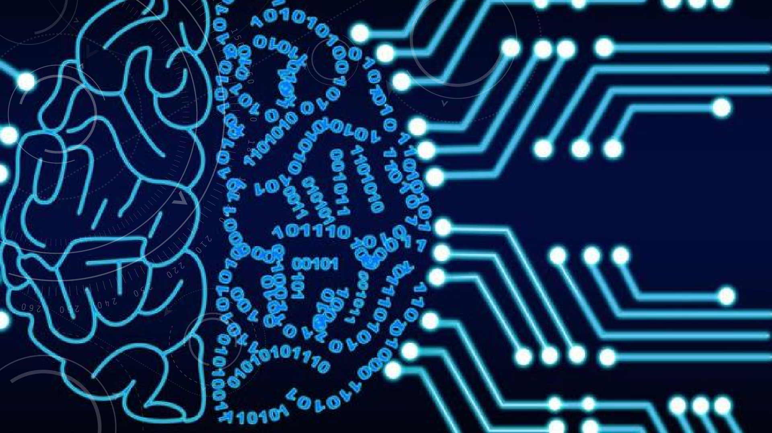


INTRODUCTION TO
ARTIFICIAL INTELLIGENCE
CHAPTER #1
Instructor: ANAUM HAMID

Slide 2
COURSE CATALOG
Introduction and Agents (chapters 1,2)
Search (chapters 3,4,5,6)
Logic (chapters 7,8,9)
Planning (chapters 11,12)
Uncertainty (chapters 13,14)
Learning (chapters 18,20)
Reinforcement Learning

Slide 3
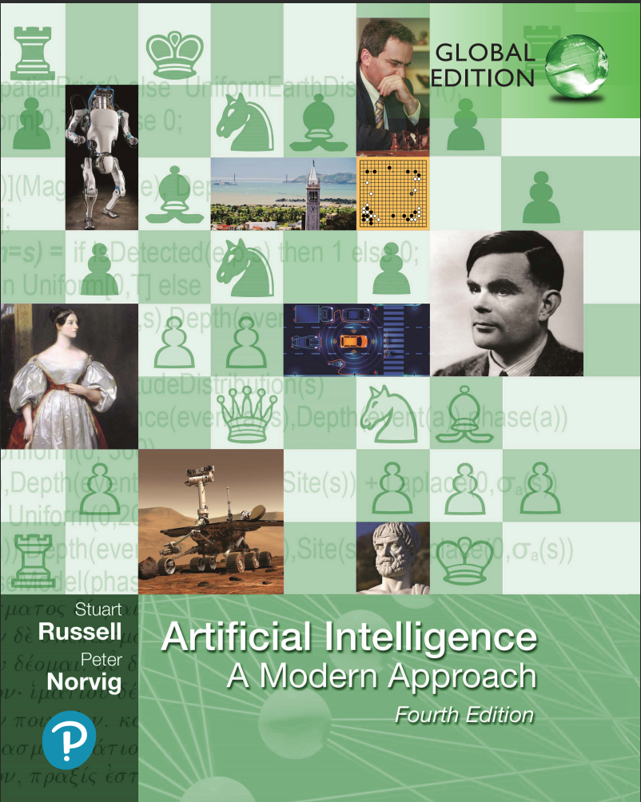
TEXTBOOK
Artificial intelligence: A modern approach (4rd edition), Stuart Russell and Peter Norvig

Slide 4
MARKS DISTRIBUTION
Assignments
Midterms
10 (Best 3 out of 4)
15 each (x2= 30)
Quiz 10 (Best 3 out of 4)
Final 50

Slide 5
AGENDA
Introduction to artificial intelligence?
A very brief history of AI
Foundations of AI
AI state of Art
– How much progress has been made in different aspects of AI

Slide 6








WHAT MAKES HUMAN INTELLIGENT?
Learning and Adapting by
Learn
Experiences from Surroundings
Problem solving
(Game theory)
Think
Make Decisions
YES/NO

Slide 7







I can show human like intelligence
Think
Make Decisions

Slide 8
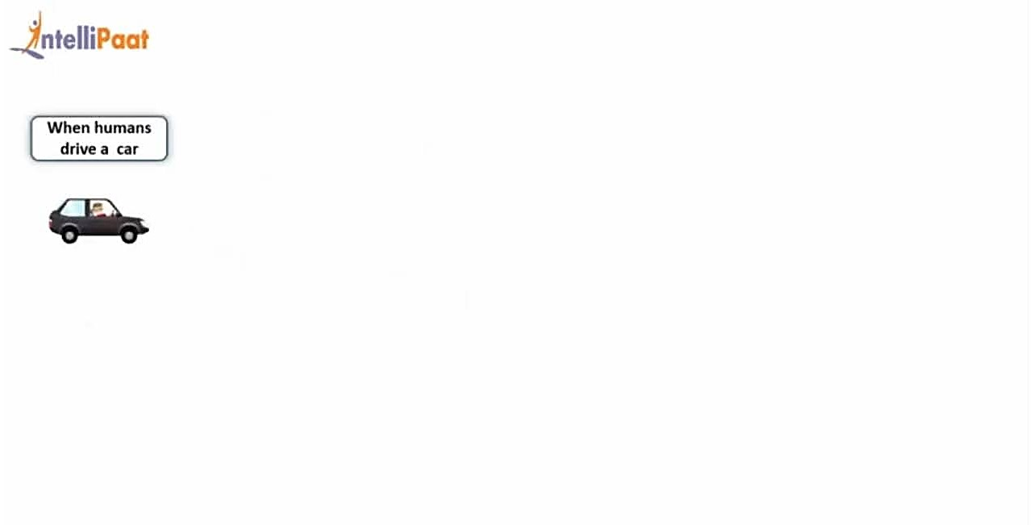
Human intelligence

Slide 9
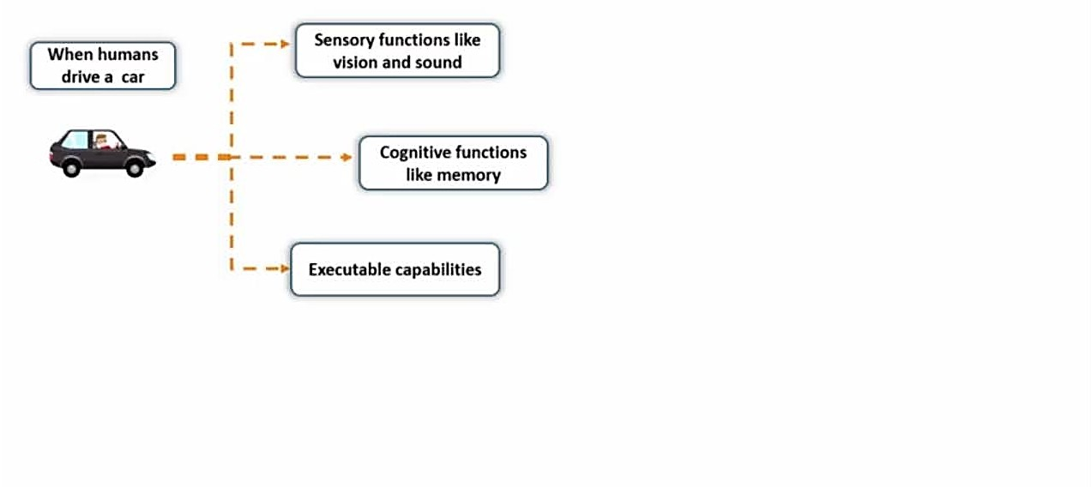

Slide 10
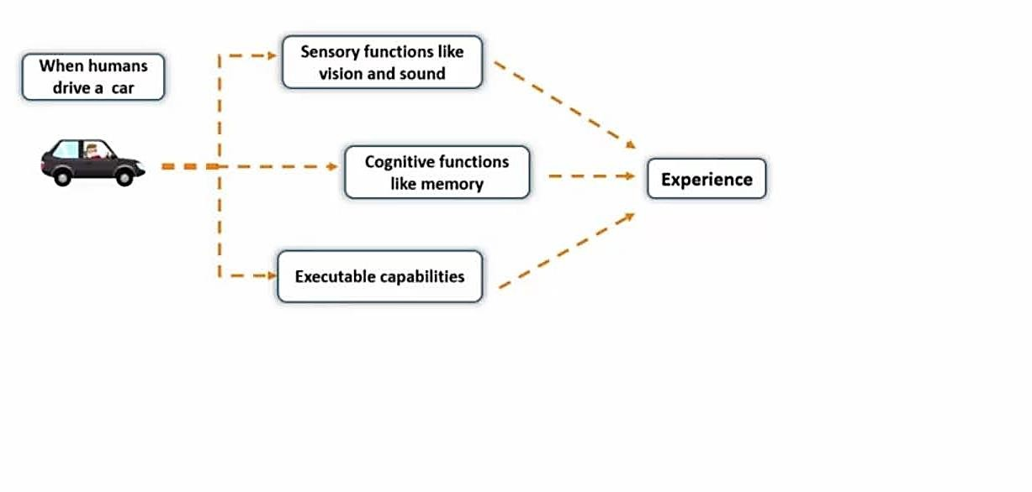

Slide 11
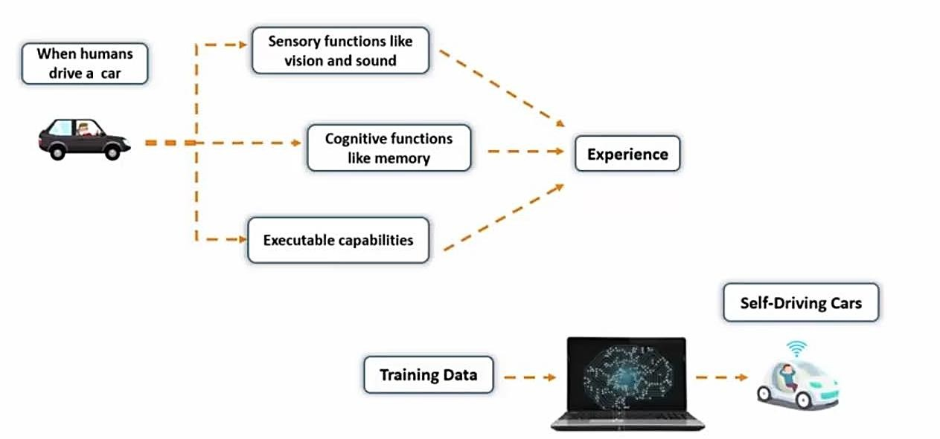

Slide 12
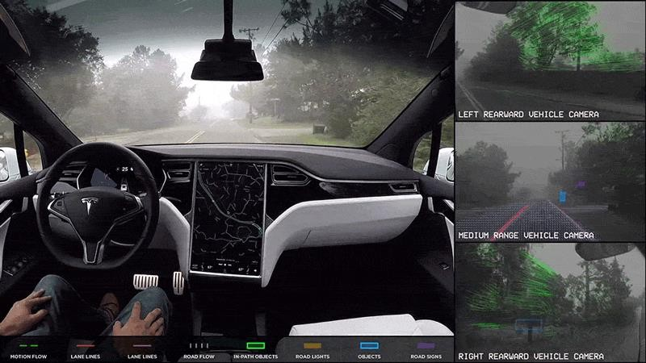

Slide 13
What is AI ?

Slide 14
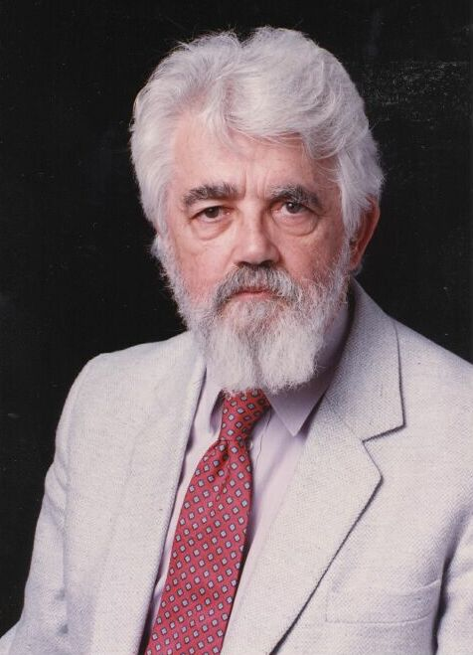
AI Definition by John McCarthy (American computer scientist and cognitive scientist)
What is artificial intelligence?
It is the science and engineering of making intelligent machines, especially intelligent computer programs
http://www-formal.stanford.edu/jmc/whatisai/whatisai.html

Slide 15
AI Definition by John McCarthy
What is intelligence
Intelligence is the computational part of the ability to achieve goals in the world
http://www-formal.stanford.edu/jmc/whatisai/whatisai.html

Slide 16
What is an AI?
“The study and design of intelligent agents, where an intelligent agent is a system that perceives its environment and takes actions that maximize its chances of success.”
Russel and Norvig, AIMA
book

Slide 17
HISTORY OF AI
1950: Turing
Turing's "Computing Machinery and Intelligence“
1956: birth of AI
Dartmouth meeting: "Artificial Intelligence“ name adopted
1950s: initial promise
Early AI programs, including
Samuel's checkers program
Newell & Simon's Logic Theory
1986-- Rise of machine learning
Neural networks return to popularity
Major advances in machine learning algorithms and applications
1990-- Role of uncertainty
Bayesian networks as a knowledge representation framework
1995-- AI as Science
Integration of learning, reasoning, knowledge representation
AI methods used in vision, language, data mining, etc

Slide 18
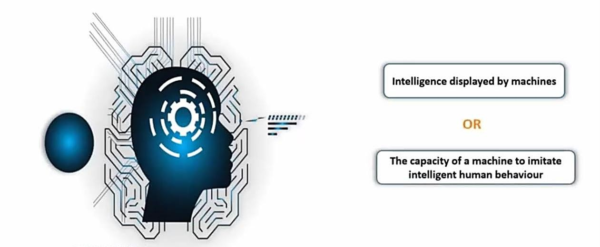
Artificial Intelligence

Slide 19
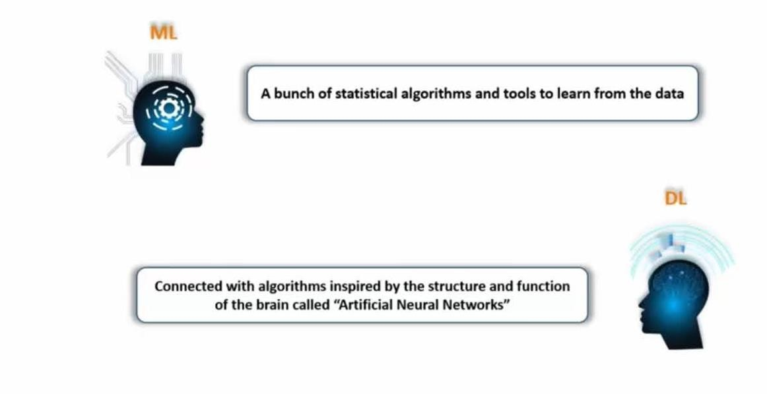
ML and DL

Slide 20
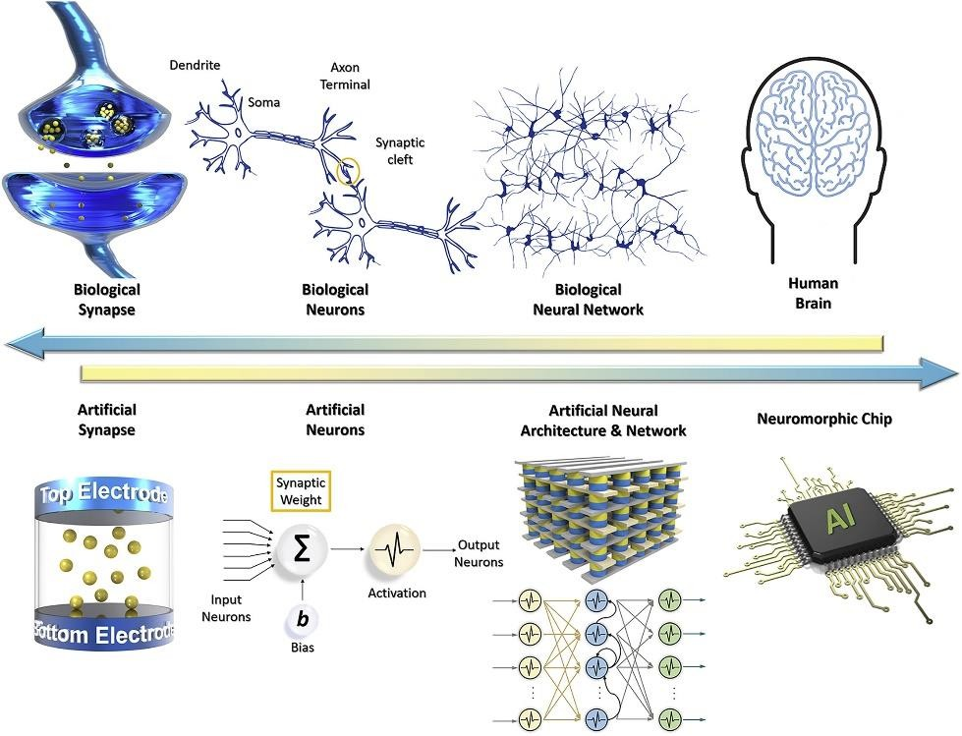
DL (BIOLOGICAL NEURON)

Slide 21
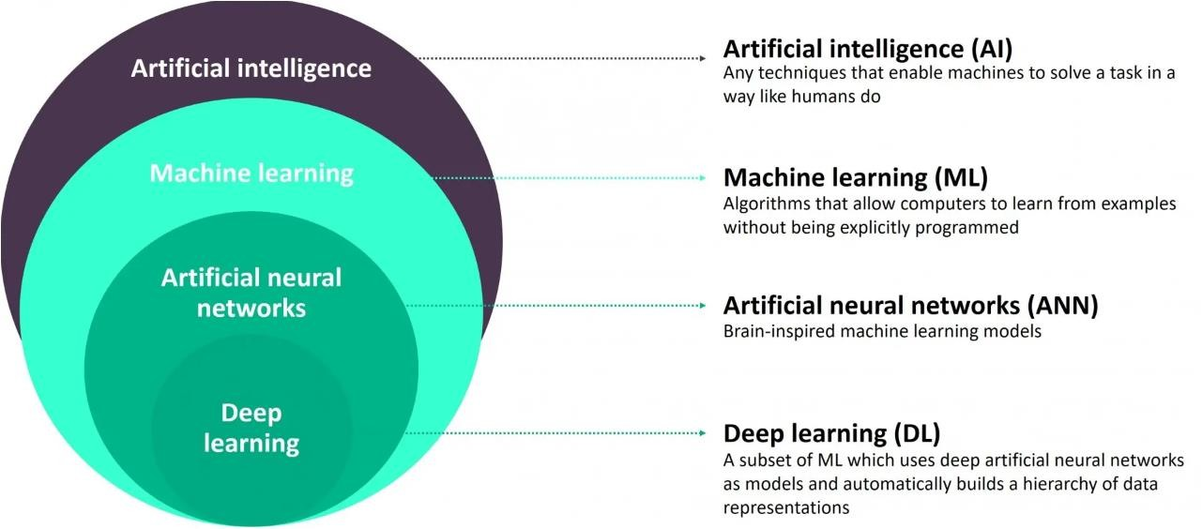
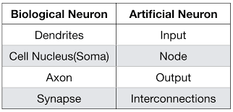
(BIOLOGICAL NEURON)

Slide 22
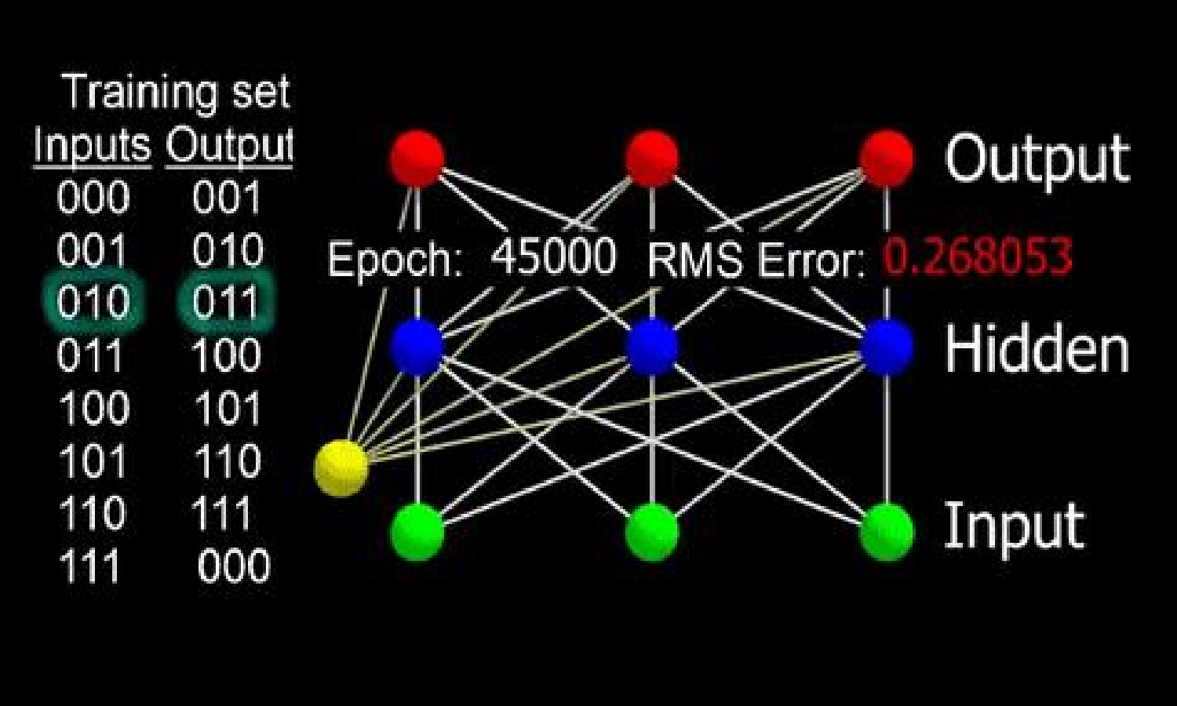
ARTIFICIAL NEURON

Slide 23
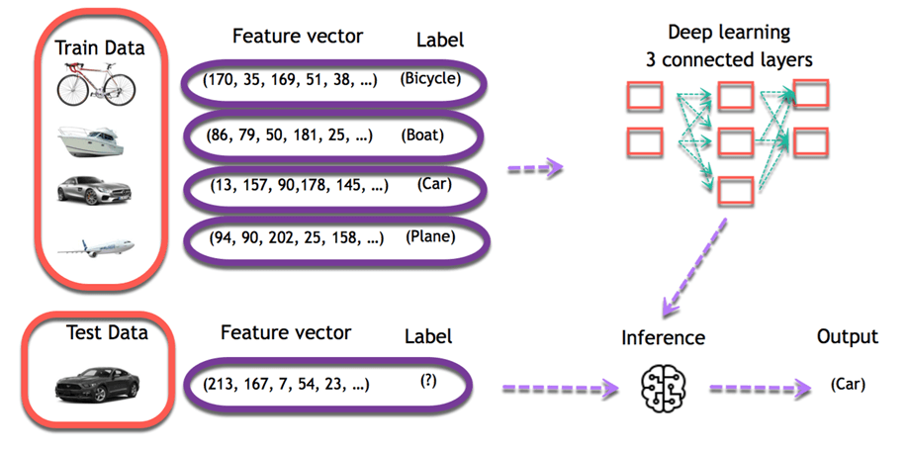

Slide 24
STATE OF THE ART
Deep Blue defeated the reigning world chess champion Garry Kasparov in 1997
AI program proved a mathematical conjecture (Robbins conjecture) unsolved for
decades
NASA's on-board autonomous planning program controlled the scheduling of operations for a spacecraft
Speech recognition: A traveler calling United Airlines to book a flight can have the entire conversation guided by an automated speech recognition and dialog management system.
Face recognition software available in consumer cameras

Slide 25
WHAT IS ARTIFICIAL INTELLIGENCE?
It is the science and engineering of making intelligent machines, especially intelligent computer programs. It is related to the similar task of using computers to understand human intelligence, but AI does not have to confine itself to methods that are biologically observable.
Views of AI fall into four categories:
Thinking Humanly
Acting Humanly
Thinking Rationally
Acting Rationally

Slide 26
Definitions
Thinking Humanly The automation of activities that we associate with human thinking… (Bellman) | Thinking Rationally The study of the computations that make it possible to perceive, reason, and act (Wilson) | Thought
Acting Humanly The study of how to make computers do things at which, at the moment, people are better (Rich and Knight) | Acting Rationally AI is concerned with intelligent behavior in artifacts (Nilsson) | Behaviour
Human performance metric: involving observations and hypothesis | Ideal or rational performance metric: combination of mathematics and engineering

Slide 27
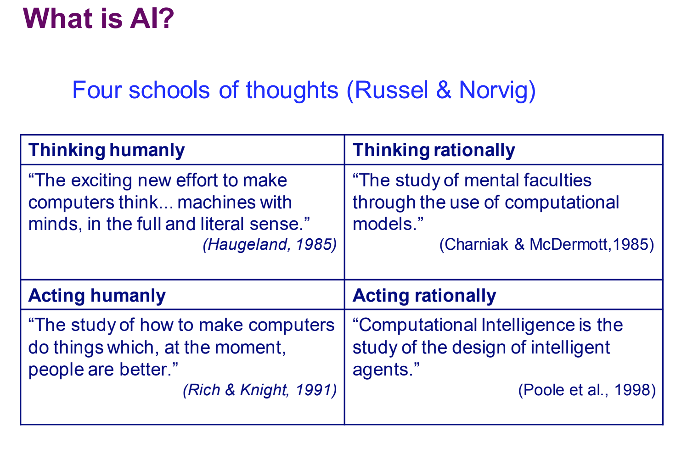

Slide 28
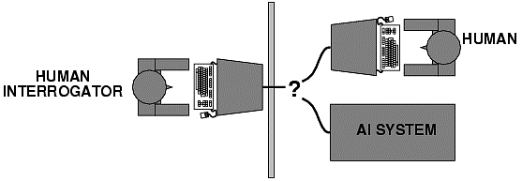
ACTING HUMANLY: TURING TEST
Alan Turing (1950) "Computing machinery and intelligence“
"Can machines think?" 🡪 "Can machines behave intelligently?“
Operational test for intelligent behavior: the Imitation Game
It was designed to provide a satisfactory operational definition of intelligence. A computer passes the test if a human interrogator, after posing some written questions, cannot tell whether the written responses come from a person or from a computer.

Slide 29
THINKING HUMANLY: THE COGNITIVE MODELING APPROACH
Requires detailed matching of computer behavior and timing to detailed
measurements of human subjects gathered in psychological experiments.
Cognitive Science approach
Try to get “inside” our minds
E.g., conduct experiments with people to try to “reverse-engineer” how we reason, learning, remember, predict
So, we need to get inside the actual workings of human minds.
There are three ways to do this:
through introspection—trying to catch our own thoughts as they go by;
through psychological experiments—observing a person in action;
and through brain imaging—observing the brain in action.

Slide 30
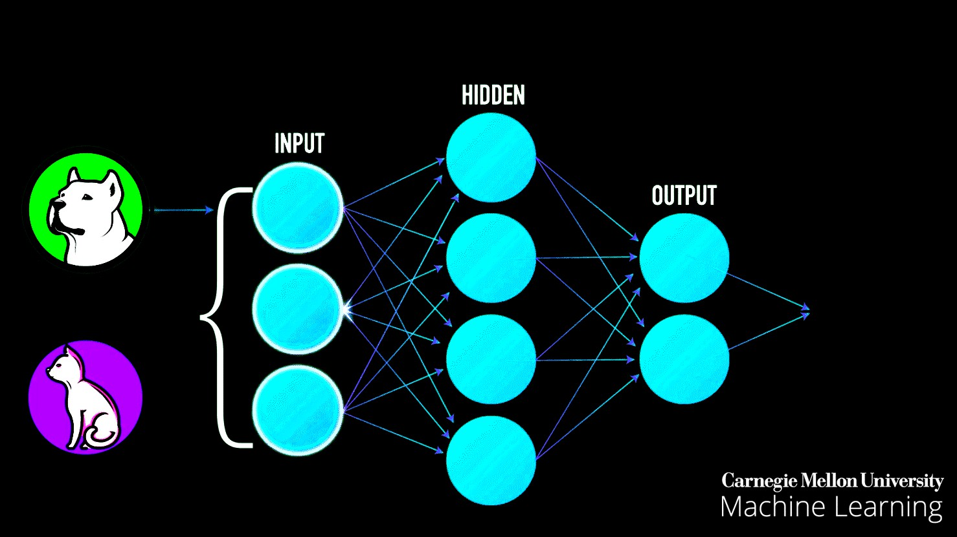

Slide 31
THINKING RATIONALLY: LAWS OF THOUGHT
Formalize “correct” reasoning using a mathematical model (e.g. of deductive reasoning/logical
conclusion).
Logics Program: Encode knowledge in formal logical statements and use mathematical deduction to perform reasoning:
Problems:
-Formalizing common sense knowledge is difficult.
-General deductive inference is computationally intractable.
the pigeon experiment classic box-and-banana problem
https://www.youtube.com/watch?v=mDntbGRPeEU

Slide 32
ACTING RATIONALLY: THE RATIONAL AGENT
An agent is an entity that perceives its environment and is able to execute actions to change it.
Agents have inherent goals that they want to achieve (e.g. survive, reproduce).
A rational agent acts in a way to maximize the achievement of its goals.
True maximization of goals requires omniscience and unlimited computational
abilities.
Limited rationality involves maximizing goals within the computational and other resources available.

Slide 33
FOUNDATIONS OF ARTIFICIAL INTELLIGENCE
Philosophy
Logic, methods of reasoning, mind as physical system,
foundations of learning, language , rationality.
formal representation and proof, algorithms , computation.
Mathematics
Probability/statistics modeling uncertainty, learning from data
Economics
Neuroscience
utility, decision theory, rational economic agents
neurons as information processing units. building fast computers
Computer
engineering
Psychology
how do people behave, perceive, process cognitive science
information, represent knowledge.
Linguistics
knowledge representation, grammars

Slide 34
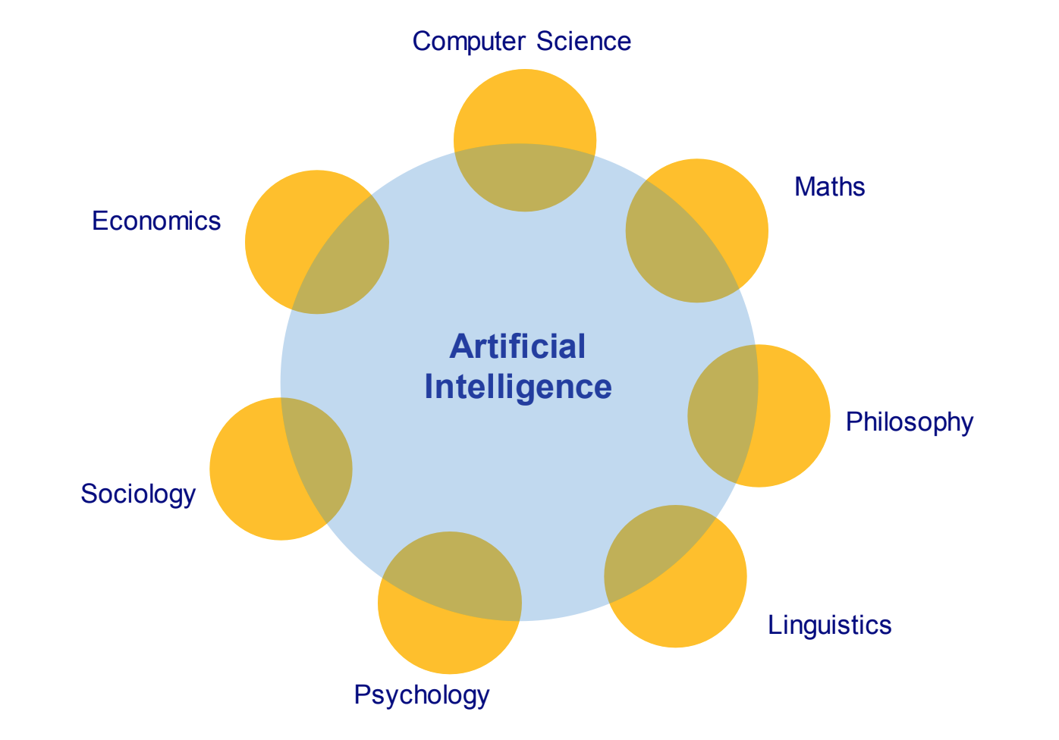
FOUNDATIONS OF ARTIFICIAL INTELLIGENCE

Slide 35
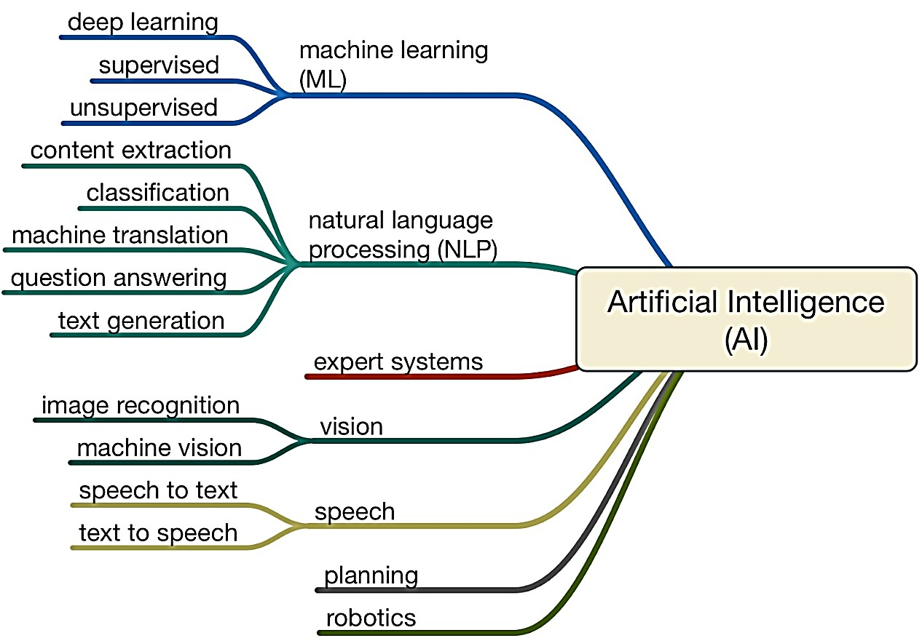
AI UMBRELLA

